Slide 1
Huffman Coding: An Application of Binary Trees and Priority Queues
Tahmid Mosaddeque
Department of CSE, UIU

Slide 2
Prefix Code
Type of code system
typically a variable-length code
Distinguished by its possession of the "prefix property”
There is no code word in the system that is a prefix (initial segment) of any other code word in the system.
For example, a code with code words {9, 55} has the prefix property;
A code consisting of {9, 5, 59, 55} does not.
Because "5" is a prefix of "59" and "55".
A prefix code is a uniquely decodable code.
A receiver can identify each word without requiring a special marker between words.

Slide 3
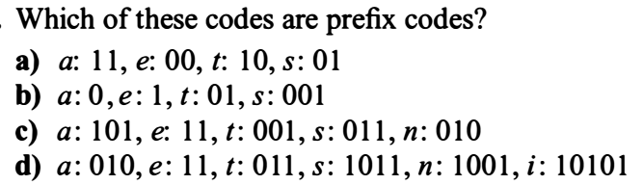
Prefix Code

Slide 4
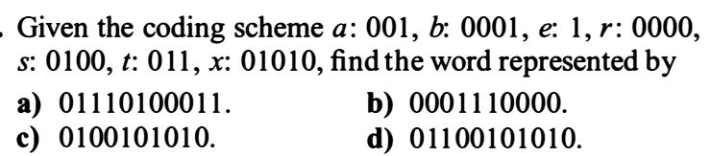
Prefix Code

Slide 5
Encoding and Compression of Data
Fax Machines
ASCII
Variations on ASCII
min number of bits needed
cost of savings
patterns
modifications

Slide 6
Purpose of Huffman Coding
Proposed by Dr. David A. Huffman in 1952
“A Method for the Construction of Minimum Redundancy Codes”
Applicable to many forms of data transmission
Our example: text files
Notes:
An Introduction to Huffman Coding
March 21, 2000
Mike Scott
6

Slide 7
The Basic Algorithm
Huffman coding is a form of statistical coding
Not all characters occur with the same frequency!
Yet all characters are allocated the same amount of space
1 char = 1 byte, be it e or x
Notes:
An Introduction to Huffman Coding
March 21, 2000
Mike Scott
7

Slide 8
The Basic Algorithm
Any savings in tailoring codes to frequency of character?
Code word lengths are no longer fixed like ASCII.
Code word lengths vary and will be shorter for the more frequently used characters.
Notes:
An Introduction to Huffman Coding
March 21, 2000
Mike Scott
8

Slide 9
The (Real) Basic Algorithm
1. Scan text to be compressed and tally occurrence of all characters.
2. Sort or prioritize characters based on number of occurrences in text.
3. Build Huffman code tree based on prioritized list.
4. Perform a traversal of tree to determine all code words.
5. Scan text again and create new file using the Huffman codes.
Notes:
An Introduction to Huffman Coding
March 21, 2000
Mike Scott
9

Slide 10
Building a Tree Scan the original text
Consider the following short text:
Eerie eyes seen near lake.
Count up the occurrences of all characters in the text
Notes:
An Introduction to Huffman Coding
March 21, 2000
Mike Scott
10

Slide 11
Building a Tree Scan the original text
Eerie eyes seen near lake.
What characters are present?
E e r i space
y s n a r l k .
Notes:
An Introduction to Huffman Coding
March 21, 2000
Mike Scott
11

Slide 12
Building a Tree Scan the original text
Eerie eyes seen near lake.
What is the frequency of each character in the text?
Char Freq. Char Freq. Char Freq.
E 1 y 1 k 1
e 8 s 2 . 1
r 2 n 2
i 1 a 2
space 4 l 1
Notes:
An Introduction to Huffman Coding
March 21, 2000
Mike Scott
12

Slide 13
Building a Tree Prioritize characters
Create binary tree nodes with character and frequency of each character
Place nodes in a priority queue
The lower the occurrence, the higher the priority in the queue
Notes:
An Introduction to Huffman Coding
March 21, 2000
Mike Scott
13

Slide 14
Building a Tree
The queue after inserting all nodes
E
1
i
1
y
1
l
1
k
1
.
1
r
2
s
2
n
2
a
2
sp
4
e
8
Notes:
An Introduction to Huffman Coding
March 21, 2000
Mike Scott
14

Slide 15
Building a Tree
While priority queue contains two or more nodes
Create new node
Dequeue node and make it left subtree
Dequeue next node and make it right subtree
Frequency of new node equals sum of frequency of left and right children
Enqueue new node back into queue
Notes:
An Introduction to Huffman Coding
March 21, 2000
Mike Scott
15

Slide 16
Building a Tree
E
1
i
1
y
1
l
1
k
1
.
1
r
2
s
2
n
2
a
2
sp
4
e
8
Notes:
An Introduction to Huffman Coding
March 21, 2000
Mike Scott
16

Slide 17
Building a Tree
y
1
l
1
k
1
.
1
r
2
s
2
n
2
a
2
sp
4
e
8
2
E
1
i
1
Notes:
An Introduction to Huffman Coding
March 21, 2000
Mike Scott
17

Slide 18
Building a Tree
y
1
l
1
k
1
.
1
r
2
s
2
n
2
a
2
2
sp
4
e
8
E
1
i
1
Notes:
An Introduction to Huffman Coding
March 21, 2000
Mike Scott
18

Slide 19
Building a Tree
k
1
.
1
r
2
s
2
n
2
a
2
2
sp
4
e
8
E
1
i
1
2
y
1
l
1
Notes:
An Introduction to Huffman Coding
March 21, 2000
Mike Scott
19

Slide 20
Building a Tree
k
1
.
1
r
2
s
2
n
2
a
2
2
2
sp
4
e
8
y
1
l
1
E
1
i
1
Notes:
An Introduction to Huffman Coding
March 21, 2000
Mike Scott
20

Slide 21
Building a Tree
r
2
s
2
n
2
a
2
2
2
sp
4
e
8
y
1
l
1
E
1
i
1
2
k
1
.
1
Notes:
An Introduction to Huffman Coding
March 21, 2000
Mike Scott
21

Slide 22
Building a Tree
r
2
s
2
n
2
a
2
2
2
sp
4
e
8
2
E
1
i
1
y
1
l
1
k
1
.
1
Notes:
An Introduction to Huffman Coding
March 21, 2000
Mike Scott
22

Slide 23
Building a Tree
n
2
a
2
2
sp
4
e
8
2
2
E
1
i
1
y
1
l
1
k
1
.
1
4
r
2
s
2
Notes:
An Introduction to Huffman Coding
March 21, 2000
Mike Scott
23

Slide 24
Building a Tree
n
2
a
2
2
sp
4
e
8
2
2
4
E
1
i
1
y
1
l
1
k
1
.
1
r
2
s
2
Notes:
An Introduction to Huffman Coding
March 21, 2000
Mike Scott
24

Slide 25
Building a Tree
2
4
e
8
2
2
sp
4
y
1
l
1
k
1
.
1
r
2
s
2
E
1
i
1
4
n
2
a
2
Notes:
An Introduction to Huffman Coding
March 21, 2000
Mike Scott
25

Slide 26
Building a Tree
2
4
4
e
8
2
2
sp
4
y
1
l
1
k
1
.
1
r
2
s
2
n
2
a
2
E
1
i
1
Notes:
An Introduction to Huffman Coding
March 21, 2000
Mike Scott
26

Slide 27
Building a Tree
4
4
e
8
2
sp
4
k
1
.
1
r
2
s
2
n
2
a
2
4
2
2
E
1
i
1
y
1
l
1
Notes:
An Introduction to Huffman Coding
March 21, 2000
Mike Scott
27

Slide 28
Building a Tree
2
4
4
4
sp
4
e
8
2
2
k
1
.
1
r
2
s
2
n
2
a
2
E
1
i
1
y
1
l
1
Notes:
An Introduction to Huffman Coding
March 21, 2000
Mike Scott
28

Slide 29
Building a Tree
4
4
4
e
8
2
2
r
2
s
2
n
2
a
2
E
1
i
1
y
1
l
1
6
2
sp
4
k
1
.
1
Notes:
An Introduction to Huffman Coding
March 21, 2000
Mike Scott
29

Slide 30
Building a Tree
4
4
4
6
e
8
2
sp
4
r
2
s
2
n
2
a
2
2
2
k
1
.
1
E
1
i
1
y
1
l
1
What is happening to the characters with a low number of occurrences?
Notes:
An Introduction to Huffman Coding
March 21, 2000
Mike Scott
30

Slide 31
Building a Tree
4
6
e
8
2
2
2
sp
4
E
1
i
1
y
1
l
1
k
1
.
1
8
4
4
r
2
s
2
n
2
a
2
Notes:
An Introduction to Huffman Coding
March 21, 2000
Mike Scott
31

Slide 32
Building a Tree
4
6
e
8
8
2
2
2
sp
4
4
4
E
1
i
1
y
1
l
1
k
1
.
1
r
2
s
2
n
2
a
2
Notes:
An Introduction to Huffman Coding
March 21, 2000
Mike Scott
32

Slide 33
Building a Tree
e
8
8
4
4
10
r
2
s
2
n
2
a
2
4
6
2
2
2
sp
4
E
1
i
1
y
1
l
1
k
1
.
1
Notes:
An Introduction to Huffman Coding
March 21, 2000
Mike Scott
33

Slide 34
Building a Tree
e
8
8
10
4
4
4
6
n
2
a
2
2
2
2
r
2
s
2
sp
4
E
1
i
1
y
1
l
1
k
1
.
1
Notes:
An Introduction to Huffman Coding
March 21, 2000
Mike Scott
34

Slide 35
Building a Tree
10
16
4
6
2
2
2
e
8
8
sp
4
E
1
i
1
y
1
l
1
k
1
.
1
4
4
r
2
s
2
n
2
a
2
Notes:
An Introduction to Huffman Coding
March 21, 2000
Mike Scott
35

Slide 36
Building a Tree
10
16
4
6
e
8
8
2
2
2
sp
4
4
4
E
1
i
1
y
1
l
1
k
1
.
1
r
2
s
2
n
2
a
2
Notes:
An Introduction to Huffman Coding
March 21, 2000
Mike Scott
36

Slide 37
Building a Tree
26
16
10
4
e
8
8
6
2
2
2
sp
4
4
4
E
1
i
1
y
1
l
1
k
1
.
1
r
2
s
2
n
2
a
2
Notes:
An Introduction to Huffman Coding
March 21, 2000
Mike Scott
37

Slide 38
Building a Tree
After enqueueing this node there is only one node left in priority queue.
26
16
10
4
e
8
8
6
2
2
2
sp
4
4
4
E
1
i
1
y
1
l
1
k
1
.
1
r
2
s
2
n
2
a
2
Notes:
An Introduction to Huffman Coding
March 21, 2000
Mike Scott
38

Slide 39
Building a Tree
Dequeue the single node left in the queue.
This tree contains the new code words for each character.
Frequency of root node should equal number of characters in text.
26
16
10
4
e
8
8
6
2
2
2
4
sp
4
4
E
1
i
1
y
1
l
1
k
1
.
1
r
2
s
2
n
2
a
2
Eerie eyes seen near lake.  26 characters
Notes:
An Introduction to Huffman Coding
March 21, 2000
Mike Scott
39

Slide 40
Encoding the File Traverse Tree for Codes
Perform a traversal of the tree to obtain new code words
Going left is a 0 going right is a 1
code word is only completed when a leaf node is reached
26
16
10
4
e
8
8
6
2
2
2
4
sp
4
4
E
1
i
1
y
1
l
1
k
1
.
1
r
2
s
2
n
2
a
2
Notes:
An Introduction to Huffman Coding
March 21, 2000
Mike Scott
40

Slide 41
Encoding the File Traverse Tree for Codes
Char Code
E 0000
i 0001
y 0010
l 0011
k 0100
. 0101
space 011
e 10
r 1100
s 1101
n 1110
a 1111
26
16
10
4
e
8
8
6
2
2
2
4
sp
4
4
E
1
i
1
y
1
l
1
k
1
.
1
r
2
s
2
n
2
a
2
Notes:
An Introduction to Huffman Coding
March 21, 2000
Mike Scott
41

Slide 42
Encoding the File
Re-scan text and encode file using new code words
Eerie eyes seen near lake.
Char Code
E 0000
i 0001
y 0010
l 0011
k 0100
. 0101
space 011
e 10
r 1100
s 1101
n 1110
a 1111
0000101100000110011100010101101101001111101011111100011001111110100100101
Why is there no need for a separator character?
Notes:
An Introduction to Huffman Coding
March 21, 2000
Mike Scott
42

Slide 43
Encoding the File Results
How is this any better?
73 bits to encode the text
ASCII would take 8 * 26 = 208 bits
0000101100000110011100010101101101001111101011111100011001111110100100101
Alternatively, as there are only 12 different characters in the text, we could have used fixed 4 bit codes for each character.
If modified code used 4 bits per character, then total bits needed will be 4 * 26 = 104.
Notes:
An Introduction to Huffman Coding
March 21, 2000
Mike Scott
43

Slide 44
Decoding the File
How does receiver know what the codes are?
Tree constructed for each text file.
Considers frequency for each file
Big hit on compression, especially for smaller files
Tree predetermined
based on statistical analysis of text files or file types
Data transmission is bit based versus byte based
Notes:
An Introduction to Huffman Coding
March 21, 2000
Mike Scott
44

Slide 45
Decoding the File
Once receiver has the tree, it starts scanning incoming bit stream
0 : go left
1 : go right
26
16
10
4
e
8
8
6
2
2
2
4
sp
4
4
10100011011110111101111110000110101
E
1
i
1
y
1
l
1
k
1
.
1
r
2
s
2
n
2
a
2

Slide 46
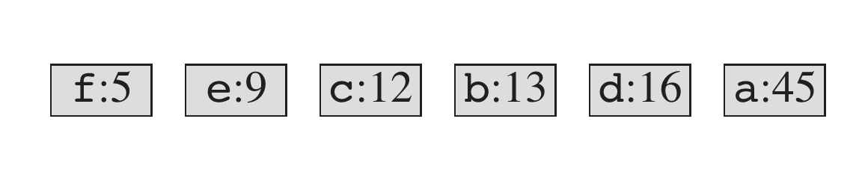
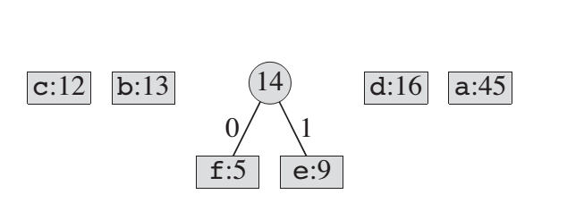
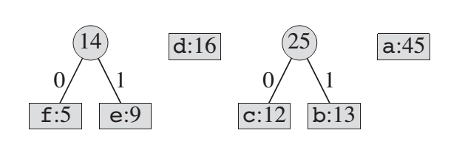

Slide 47
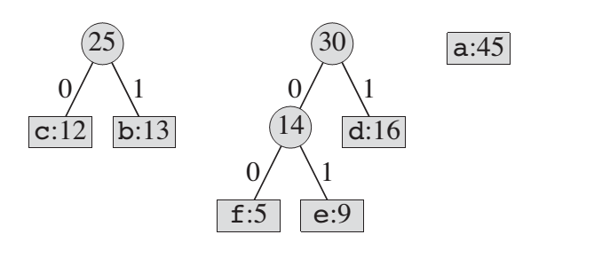
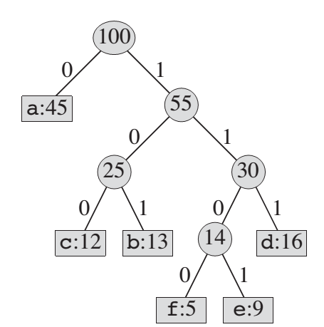
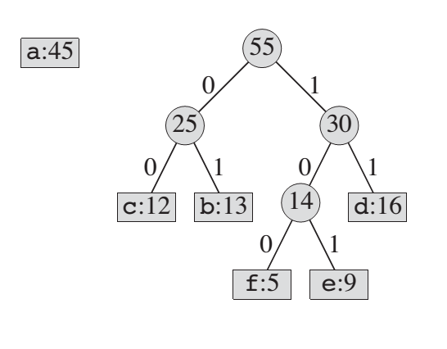

Slide 48
Average Bits Per Symbol
Average bits per symbol can be calculated by dividing the total number of required bits with the total number of characters in the text/file.
For this tree,
Total number of character = 100 (the count in root)
Total required bits = 4 (5 + 9) + 3 (12 + 13 + 16) 1 * 45 = 56 + 123 + 45 = 224
So, ABPS = 224 / 100 = 2.24

Slide 49
Modified Huffman Coding
Modified Huffman coding is used in fax machines to encode black on white images (bitmaps).
A single scan line in a fax contains only two kinds of elements white pixels and black pixels which can be represented directly as a 0 and 1. These two symbols are too small a list of items to directly apply the Huffman coding. But if we first use run-length encoding we can have more objects to encode.

Slide 50
Modified Huffman Coding
A hypothetical scan line, with B representing a black pixel and W representing white, might read as: “WWWWWWWWWWWWBWWWWWWWWWWWWBBBWWWWWWWWWWWWWWWWWWWWWWWWBWWWWWWWWWWWWWW”
With a run-length encoding (RLE) data compression algorithm applied to the above hypothetical scan line, it can be rendered as: “12W1B12W3B24W1B14W”
Here we see that we have, in addition to the two items White and Black, several different numbers. These numbers provide plenty of additional items to use; so the Huffman coding can be directly applied to the sequence above to reduce the size even more.

Slide 51
Summary
Huffman coding is a technique used to compress files for transmission
Uses statistical coding
more frequently used symbols have shorter code words
Works well for text and fax transmissions
An application that uses several data structures

Slide 52
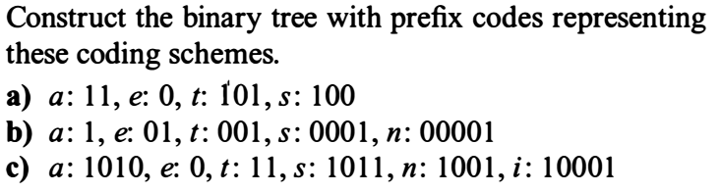
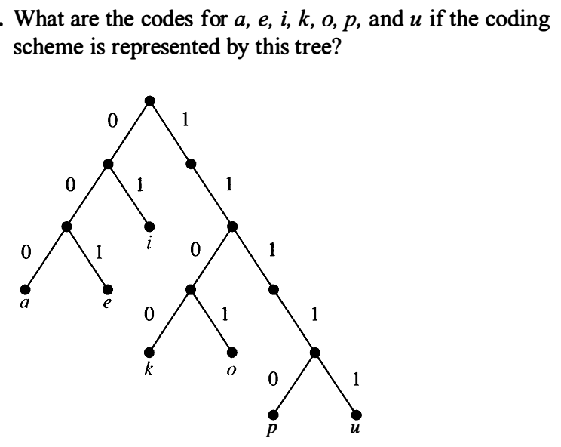

Slide 53
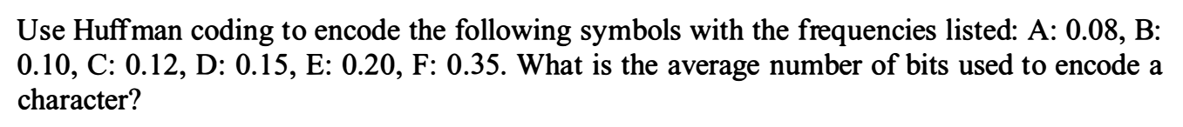
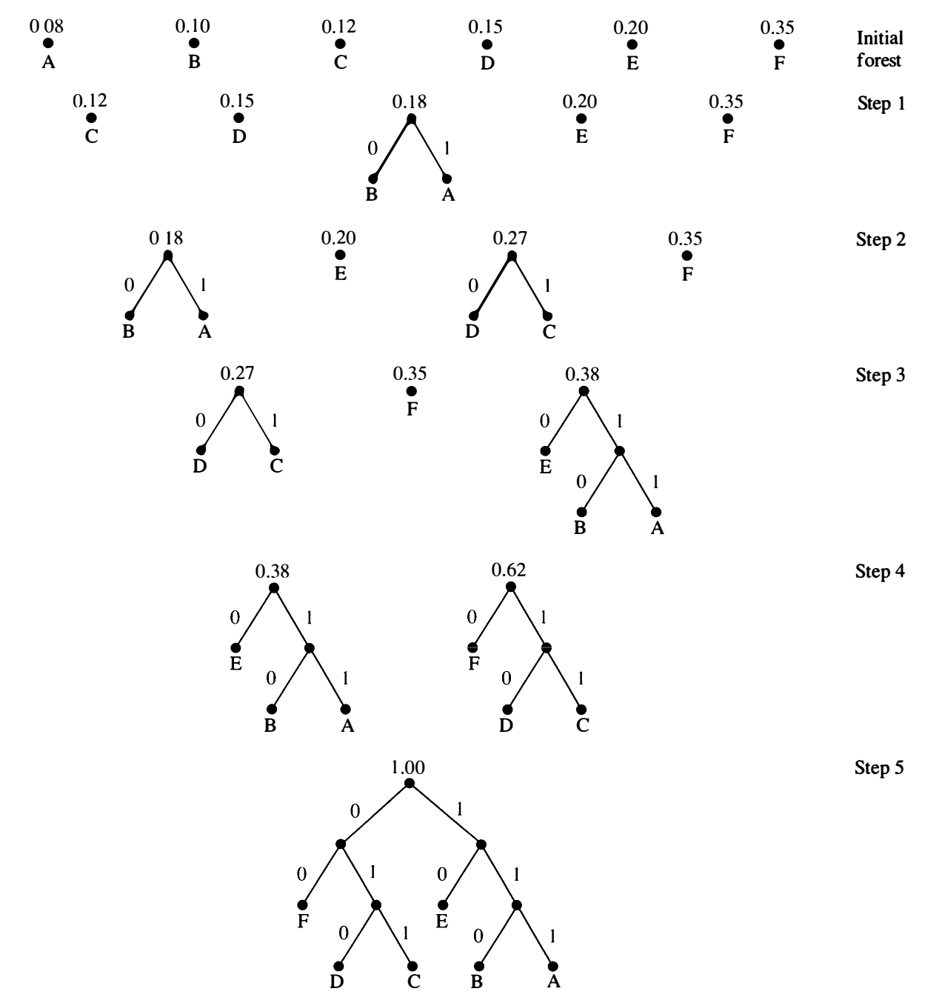
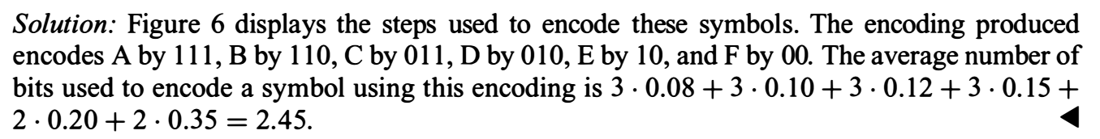

Slide 54
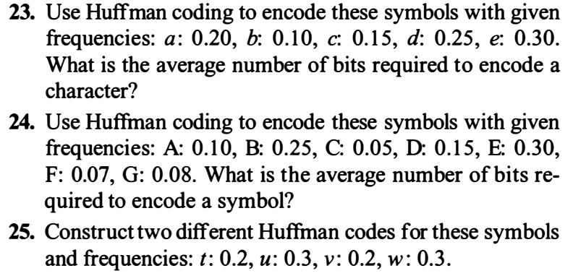

Slide 55
Study Material
CLRS: 16.3 Huffman Coding
Discrete Mathematics : Tree (Huffman Coding)

